Slide 1
Exception Handling

Slide 2
CONTENTS
1. Exception Handling
2. Exception Handling Tools
3. Exception Handling Hierarchy
4. Compile Time vs Runtime Exceptions (Checked Vs
Unchecked Exception)
5. Throw Vs Throws
6. Creating Own Exception

Slide 3

Exception Handling
Let’s look at the following situation.
A method in my program needs to open a file called "PhoneNumbers.txt". If the "PhoneNumbers.txt" file cannot be found, then I certainly do not want my program to abruptly crash.
I want to get some information about the problem, so that I can handle the potential problem by using exception handling.
An exception is any unusual condition that causes an alteration in program flow, such as a missing file or a null pointer.
“Exception Handler” catches an exceptional event occurs during Program execution
“When I'm right no one remembers..When I'm wrong no one forgets”

Slide 5
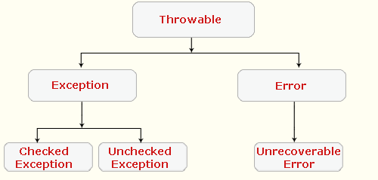

Slide 6
Exception Handling tools
Try – try is used to define a block of code in which exception can be occurred.
This block of code is also called a “Guarded region”.
Catch- catch block immediately after try block. The catch block will tell your program just what to do in case the exception actually does occur. If no exception occurs, then the catch block is ignored, and your program moves along smoothly
Finally- A finally block encloses code that is always executed at some point after the try block, whether an exception was thrown or not.
Throw- to throw an exception explicitly.
Throws – it always on method level, it means that method don't want to handle the exception and it passing an exception to the calling point.

Slide 7
Exception Handling tools Continued...
Note : It is illegal to use a try clause without either a catch clause or a finally clause.
Example: try /catch use
try
{
// this is the first line of the “guarded region”
// that is governed by the try keyword.
// Put code here that might cause some kind of exception.
}
catch(Exception ee)
{
//Put code here that handles this exception.
}
Sample Example

Slide 8
Example: NumberFormatException
class Test
{
public static void main(String args[])
{
int a,b;
try
{
a=Integer.parseInt(args[0]);
b=Integer.parseInt(args[1]);
System.out.println(a+b);
}
catch(NumberFormatException ee)
{
System.out.println(“Number Format Exception Raised because you not enter number between 0-9 “+ee);
ee.printStackTrace(); // a stack trace from where the exception occurred will be printed.
}
}
}
Sample Example

Slide 9
Example: ArrayIndexOutOfBoundsException
class Test
{
public static void main(String args[])
{
try
{
int x[]=new int[10];
x[11]=100;
}
catch(ArrayIndexOutofBoundsException ee)
{
System.out.println(ee);
}
}
}

Slide 10
Example: ArithmeticException , Multiple catch block
class Test1
{
public static void main(String args[])
{
int a,b;
try
{
a=Integer.parseInt(args[0]);
b=Integer.parseInt(args[1]);
System.out.println(a/b);
}
catch(NumberFormatException ee)
{
System.out.println(“Number Format Exception Raised “+ee);
}
catch(ArithmeticException ee)
{
System.out.println(“ArithmeticException Raised because you divide a number with zero “+ee);
}
catch(Exception ee) //this block gona be last !
{
System.out.println(“Miscellaneous Exception Raised “+ee);
}
}
}
Sample Example

Slide 11
Exception Handling tools Continued...
The following legal code demonstrates a try with a finally but no catch.
try
{
//do stuff
}
finally
{
//clean up code
}
The following legal code demonstrates a try,catch and finally.
try
{
//do stuff
}
catch(SomeException ee)
{
//do exception handling
}
finally
{
//Clean up code
}

Slide 12
Exception Handling tools Continued...
The following ILLEGAL code demonstrates a try without a catch or finally.
try
{
//do stuff
}
//Need a catch or finally here
System.out.println(“out of try block “);
The following ILLEGAL code demonstrates a misplaced catch block.
try
{
//do stuff
}
//can't have code between try/ catch
System.out.println(“Out of try block “);
catch(Exception ex)
{
}

Slide 13
Exception Hierarchy
java.lang.Object
java.lang.Throwable
Exception
Error
OutofMemoryError
RuntimeException
StackOverflowError
SQLException
IOException
ArrayIndexOutofBoundsException

Slide 14
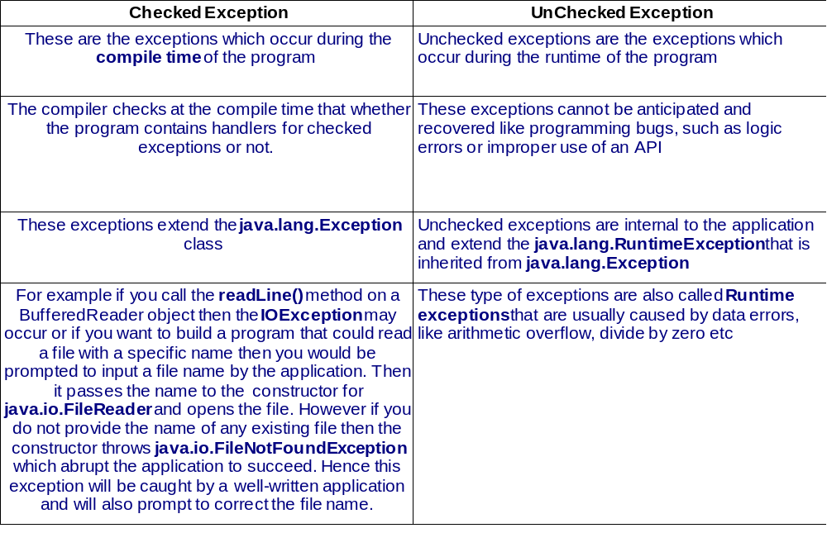
Compile Time VS RunTime Exception

Slide 15
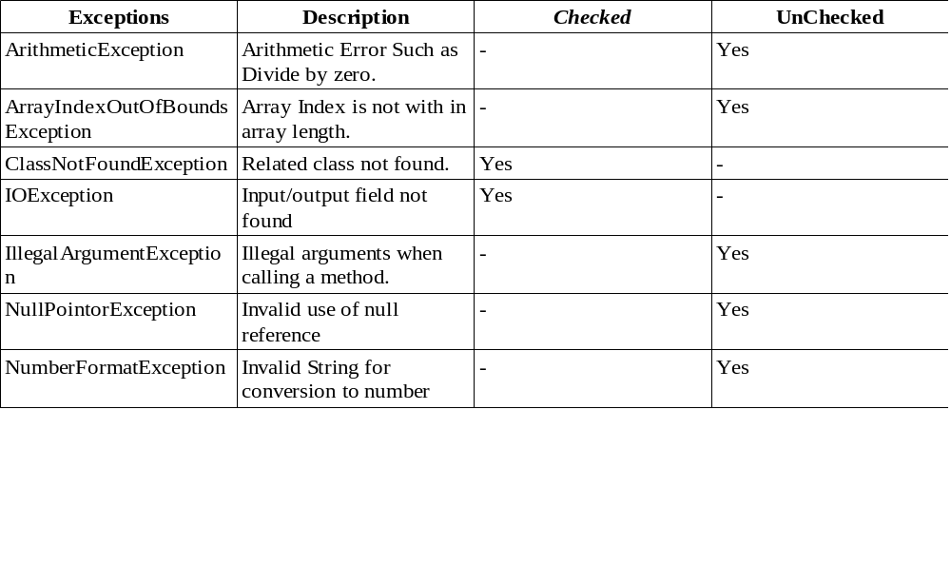
List of Checked and Unchecked Exceptions

Slide 16
throw Vs throws
Look for code that invokes a method declaring an exception, where the calling method doesn't handle or declare the checked exception. The following code (which uses the throw keyword to throw an exception manually) has two big problems that the compiler will prevent.
Example:
void doStuff()
{
doMore();
}
void doMore()
{
throw new IOException();
}
First , the doMore() method throws a checked exception, but does not declare it! But suppose we fix the doMore() method as follows:
void doMore() throws IOException
{
}
The doSuff() method is still in trouble because it ,too , must declare the IOException, unless it handles it by providing a try/catch , with a catch clause that can take an IOException.
Sample Example

Slide 17
class Exception2
{
void show() throws Exception
{
System.out.println("Inside Show ");
}
void disp() throws Exception
{
this.show();
System.out.println("Inside Disp ");
}
void output() throws Exception
{
this.disp();
System.out.println("Inside output ");
}
public static void main(String args[])
{
Exception2 obj=new Exception2();
try
{
obj.output();
}
catch(Exception ee)
{
System.out.println("Exception is "+ee);
}
}
}
throw Example
Ducked Exceptions

Slide 18
Creating Own Exception

Slide 19
STEP-1 Creating Custom Exception class
import java.io.*;
class MyException extends Exception
{
int age;
MyException()
{ }
MyException(int age)
{
this.age=age;
}
public String toString()
{
return "Age Cannot be less than 18 and your entered age is "+age+" So
u can't vote";
}
}

Slide 20
Step-2 Using CustomException
public class ExceptionDemo
{
public static void main(String[] args) throws Exception
{
BufferedReader br=new BufferedReader(new
InputStreamReader(System.in));
System.out.println("Enter the Age");
int age=Integer.parseInt(br.readLine());
try
{
if(age<18)
throw new MyException(age);
else
System.out.println("Yes you can vote ");
}
catch(MyException ee)
{
System.out.println(ee);
}
}
}
Sample Example

Slide 21
TEST YOUR SELF

Slide 22
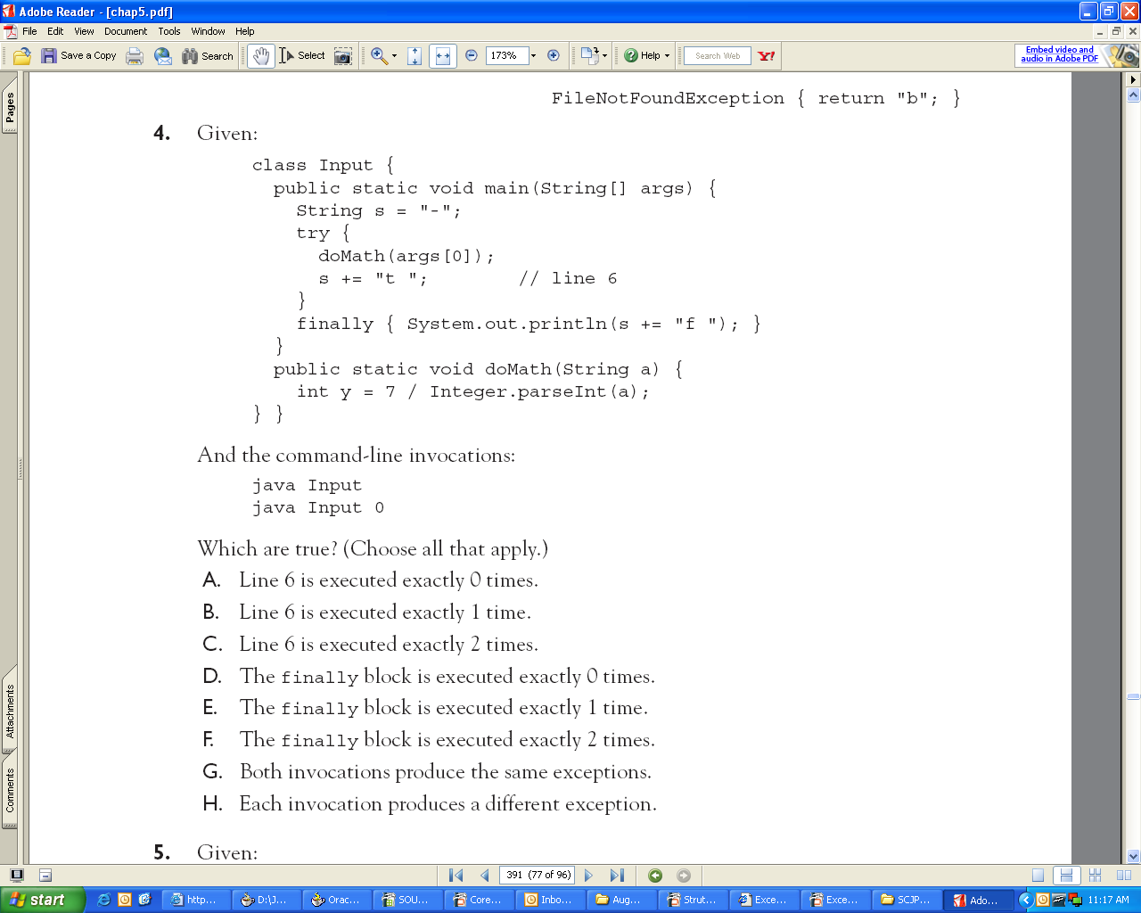
Test Your Self
java Input 0

Slide 23
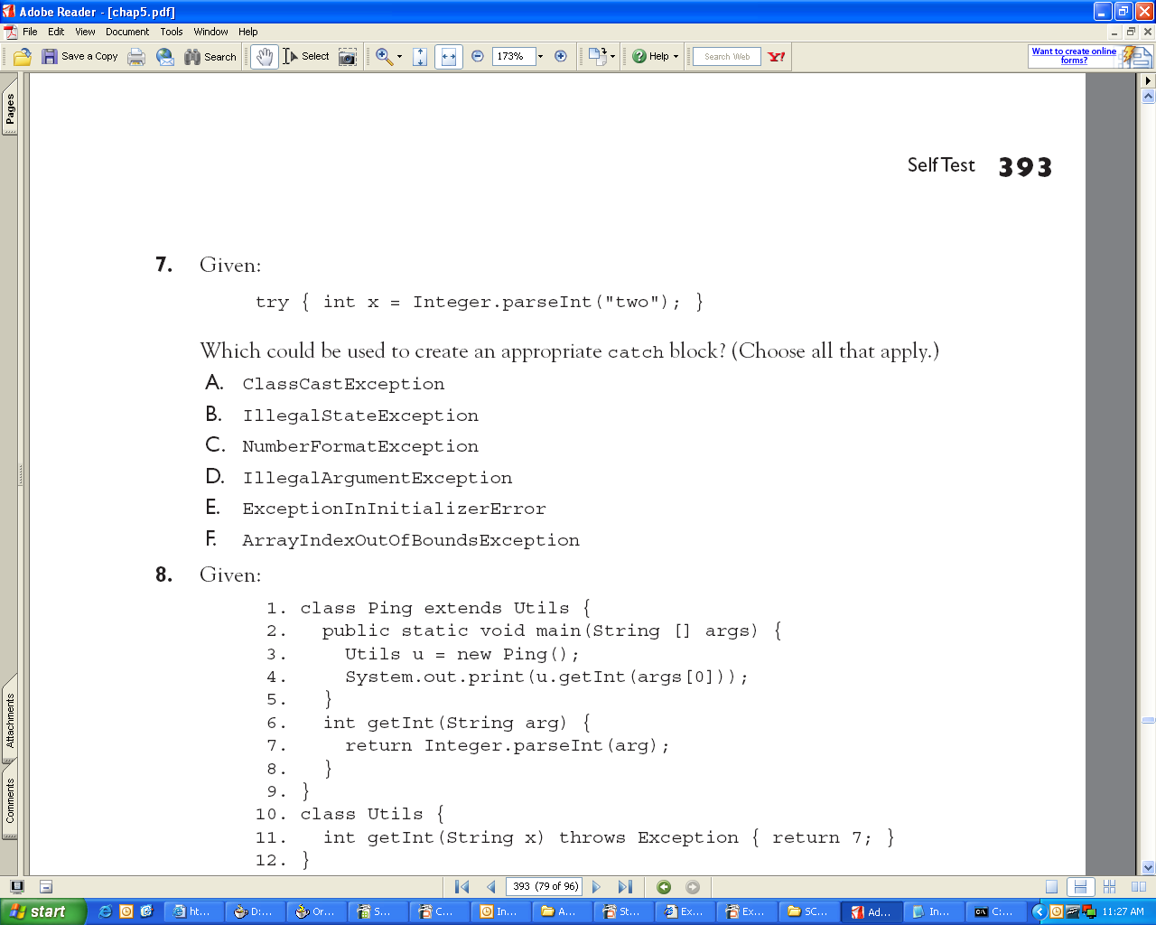
Test Your Self

Slide 24
Test Your Self
try
{
int a=10/0;
System.out.println(“Inside Try Block “);
}
catch(Exception ee)
{
System.out.println(“Inside Catch Block “);
}
finally
{
System.out.println(“Inside Finally Block “);
}
What Will be the output

Slide 25
Test Your Self
try
{
int a[]=new int[10];
a[12]=900;
}
catch(Exception ee)
{
System.out.println(“Exception is “+ee);
return ;
}
finally
{
System.out.println(“Inside Finally Block “);
}
What Will be the output ?

Slide 26
Test Your Self
try
{
int a=10/0;
}
catch(Exception ee)
{
System.out.println(Exception is “+ee);
System.exit(0);
}
finally
{
System.out.println(“Inside Finally “);
}
What is the output?

Slide 27
Exercise:
1) WAP to enter a name of the user and show an exception if it does not enter its name.
2) WAP to enter two numbers and use exception handling for numberformat and null value, then ask the user to add,subtract, multiply and divide a number.
3) WAP to create its own custom exception , Program takes user input custid , custname and give the choice to the customer to withdraw amount, Program will check the store amount with withdraw amount , if withdraw amount is greater than store amount so throw a Negative Balance Amount Exception.

